Slide 1
Software Engineering
Week 03 Lecture 01

Slide 2
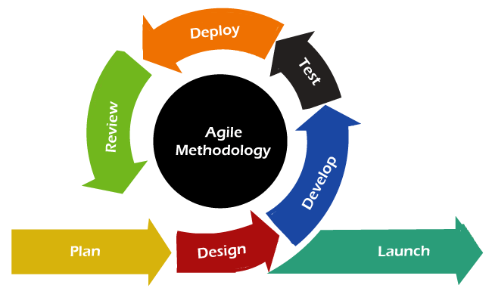
Agile Model (recall)
Fast movement
Latest
Largely used now a days
Project is divided in small modules
Modules are released and updated
Notes:
Fb, amazon, google
Small chunks-→ Release-→ Feedback → Enhance → Re-release

Slide 3
Approaches of Agile
Scrum
Crystal
FDD
eXtreme Programing (XP)
Lean Software Development

Slide 4
Scrum
An agile development process focused primarily on ways to manage tasks in team-based development conditions.
Lightweight, iterative and incremental model.
Development phases are divided into stages called Sprints.
Notes:
Sprint: Maximum work in limited time
Sprint completed one by one

Slide 5
Roles in Scrum
Documentation of requirements
Scrum Master: Manage team, arrange the meetings and remove obstacles for the process
Product Owner: makes the product backlog, responsible for the distribution of functionality on each repetition.
Scrum Team: The team manages its work and organizes the work to complete the sprint or cycle.
Notes:
Scrum master is in communication with client and team
Product owner : client

Slide 6
Terminologies in Scrum
Daily Scrum: A short (less than 30 minutes) daily Scrum Meeting allows the team to monitor status and communicate problems.
Two meetings are held
One to decide features for the next Sprint
the other to plan out the work.

Slide 7
Terminologies in Scrum (Daily Queues)
Product Backlog → Sprint Backlog → Sprint → Working increment of the Software
Product Backlog queue: a customer-managed queue of demand requests for products.
Sprint Backlog: queue for Sprint work-management.

Slide 8
Terminologies in Scrum
Burn Down: burn down chart is a publicly displayed chart showing remaining work in the sprint backlog.
Story: A feature added to the backlog is commonly referred to as a story; has a specific suggested structure.
For development team to identify user, action and required result in a request; simple way of writing requests anyone can understand.

Slide 9
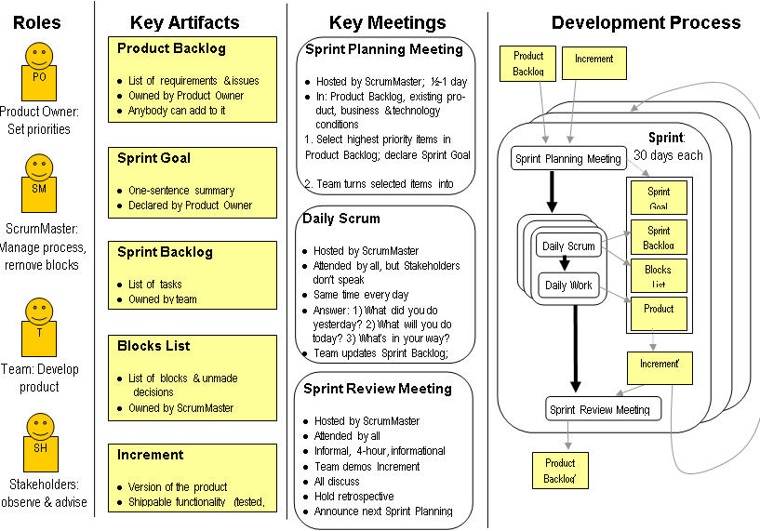

Slide 10
Advantages and Disadvantages
Flexibility
Transparency
Efficiency
Team empowerment
Continuous improvement
Learning curve
Dependency on the team
Rigid Sprints
Notes:
1- flexibility in adapting to changes in the project scope or requirements.
2- clear and transparent view of the project’s progress, tasks, and goals
3- by breaking down complex tasks into smaller, more manageable ones
4- giving them the autonomy to make decisions about their work and tasks
Scrum can be complex and challenging to learn, particularly for teams that are new to agile methodologies

Slide 11
Crystal
Chartering: Making a development team, performing feasibility analysis, developing plans
Cyclic delivery:
Team updates the release plan
Integrated product delivers to the users.
Wrap up: this phase performs deployment, post-deployment.

Slide 12
Feature Driven Development (FDD)
Delivering working software features in a timely and efficient manner
Activities:
- Develop an overall model
Build a feature list
Plan by feature
Design by feature
Build by feature
Notes:
high-level representation of the system's features and functionality
defining requirements, designing the feature, developing the code, testing the feature, and integrating it into the system.
class diagrams, sequence diagrams, and other design artifacts.

Slide 13
eXtreme Programming (XP)
Emphasizes teamwork, collaboration, and rapid feedback.
Test-driven development TDD
Pair programming
Continuous integration
Refactoring
Notes:
Refactoring: Improving code structure and design
suitable for small to medium-sized software development teams

Slide 14
Lean Software Development
“Just in time production”
Increasing speed of software development and reducing costs.
Notes:
delivering value to customers through efficient software development processes.

Slide 15
Phases of Lean Software Development
Eliminating Waste
Amplifying learning
Early delivery
Empowering the team
Building Integrity
Optimize the whole
Notes:
such as unnecessary features, redundant code, and waiting time.
encourages knowledge sharing and collaboration between team members
positive and collaborative work environment
Integrity: code ownership, code reviews, and continuous learnin

